Slide 1
Interpretable Visual Features for Demand Neuroforecasting
Brenden Eum
Brian Knutson
Shabnam Hakimi
Remi Daviet
Ryan Webb

Slide 2
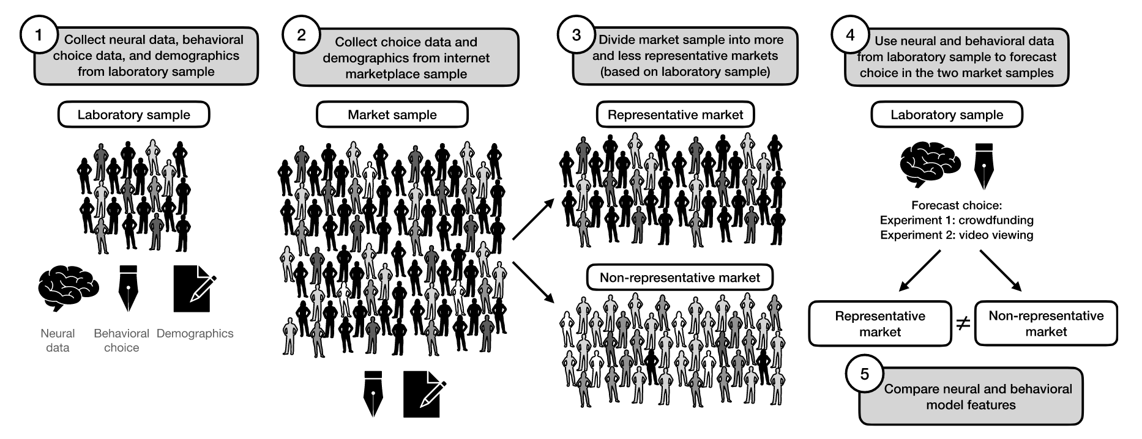
Neuroforecasting
Genevsky et al. (2025, PNAS Nexus)

Slide 3
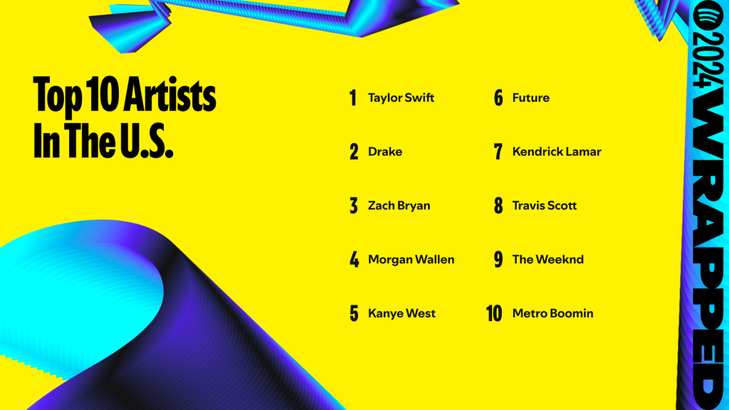







Slide 4
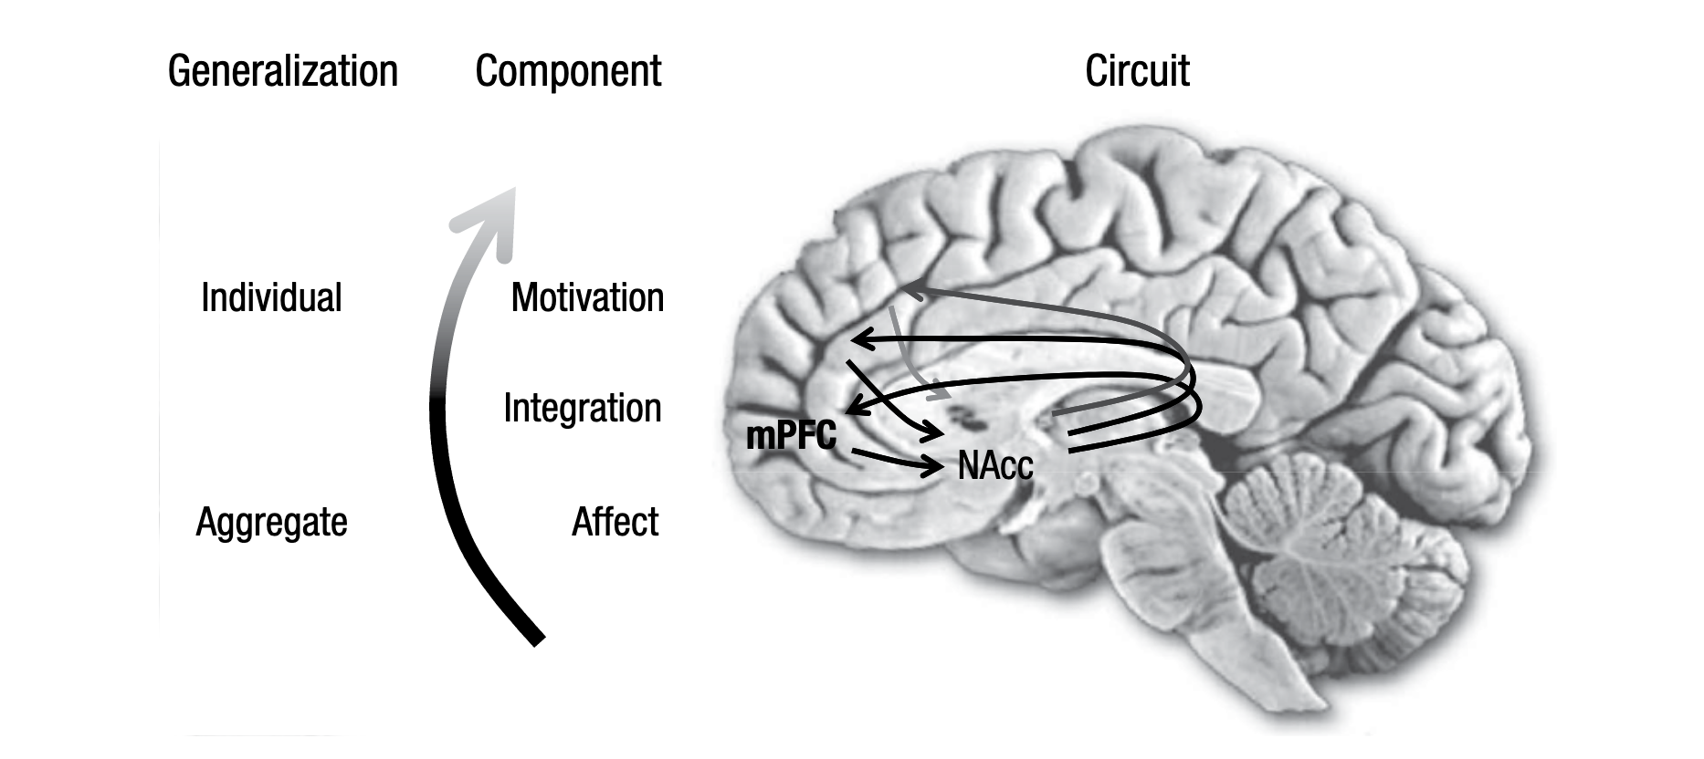
Affect-Integration-Motivation (AIM) Network
Knutson & Genevsky (2018, Cur Dir Psych Sci)

Slide 5
Affect-Integration-Motivation (AIM) Network
What influences affective response in the NAcc?
Knutson & Genevsky (2018, Cur Dir Psych Sci)

Slide 6
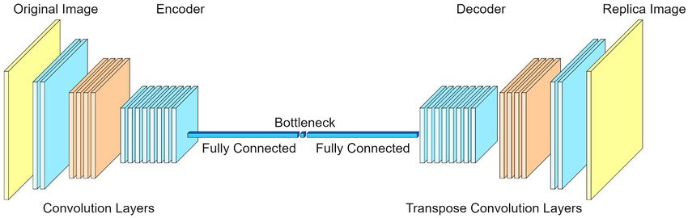
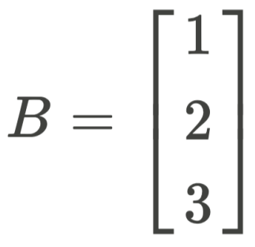
Machine Learning might provide an answer.

Slide 7
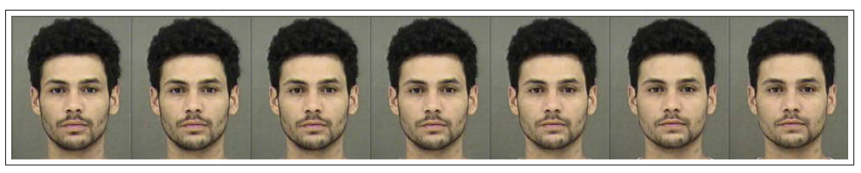
Latent Traversals
-2
-1
0
2
3
4
Ludwig & Mullainathan (2024, QJE)

Slide 8
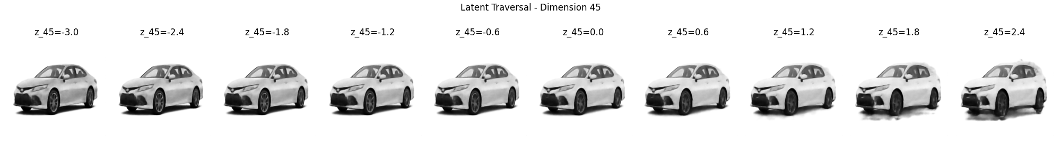
Interpretable Visual Features for Cars
Hood Shape
Grill Shape
Headlight Shape

Slide 9
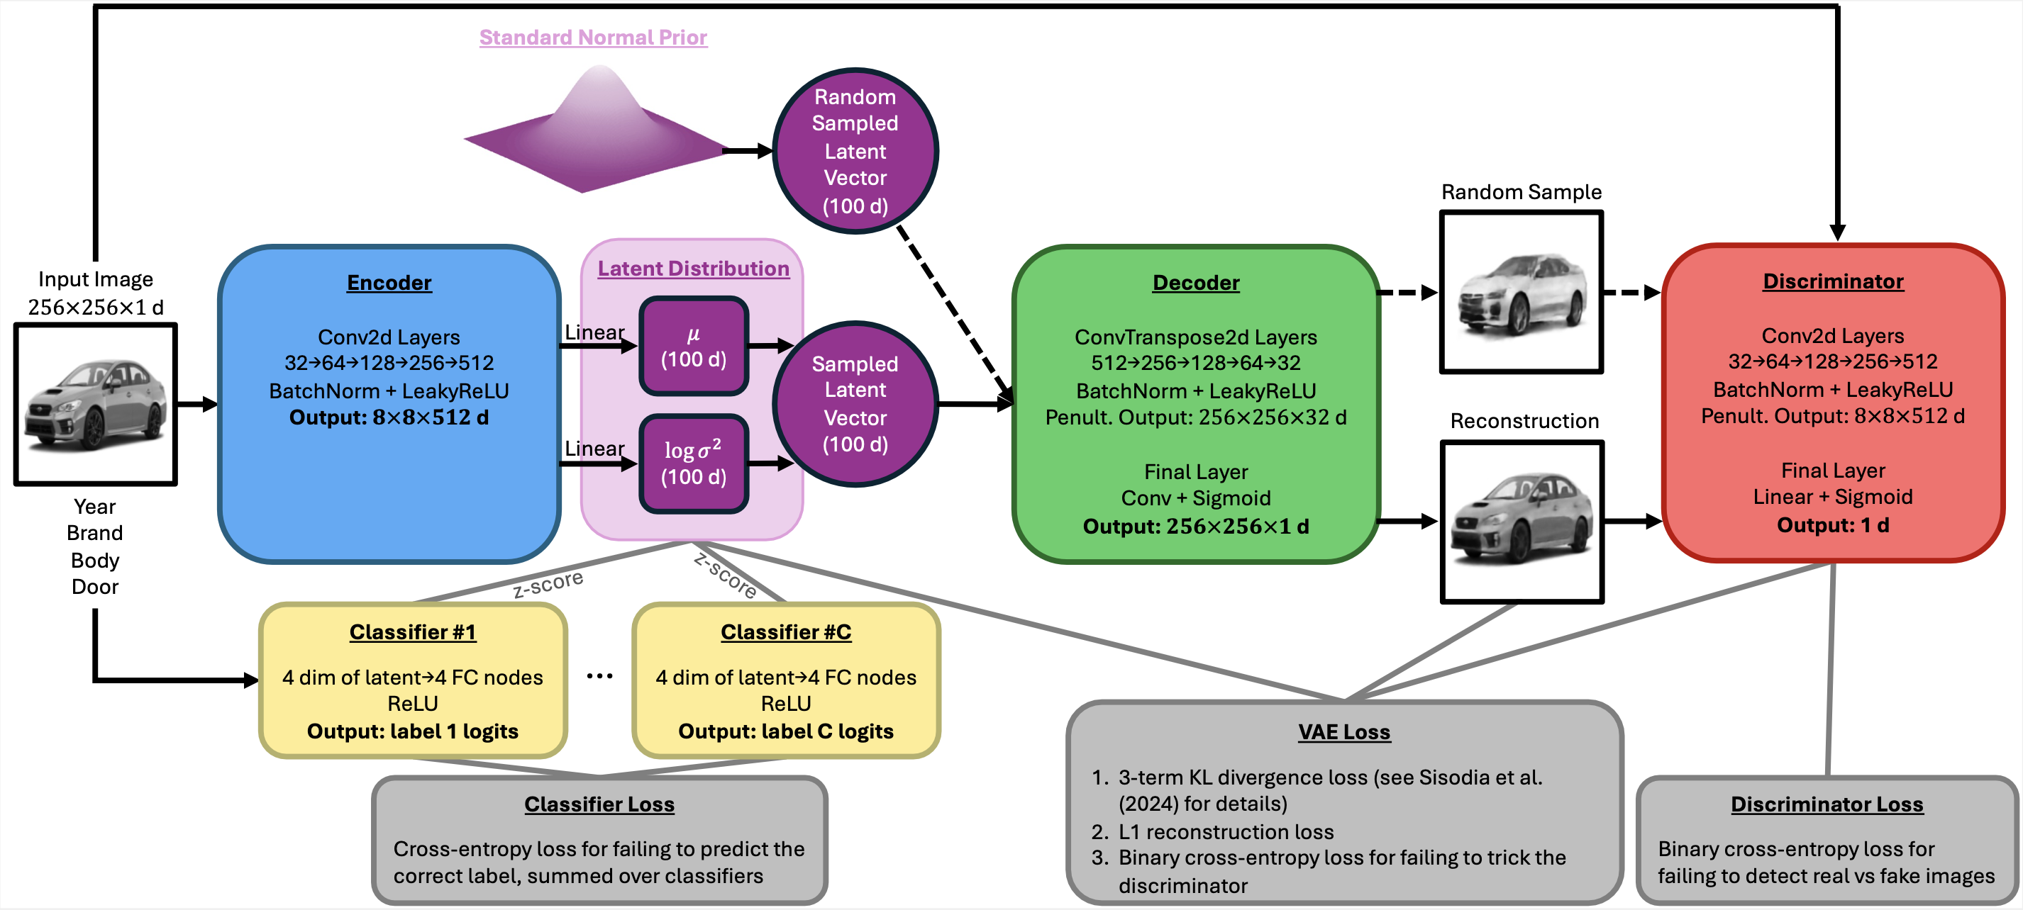
motorVAEGAN

Slide 10
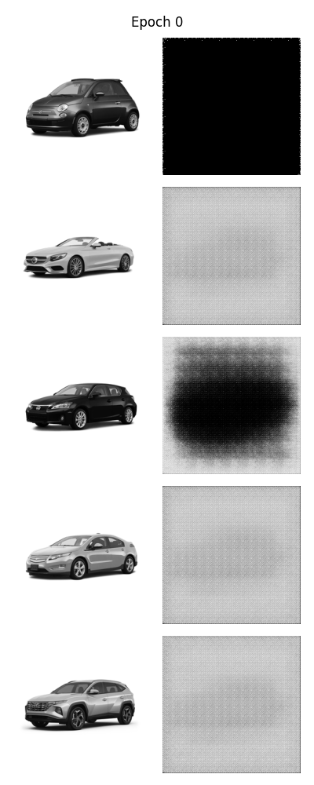
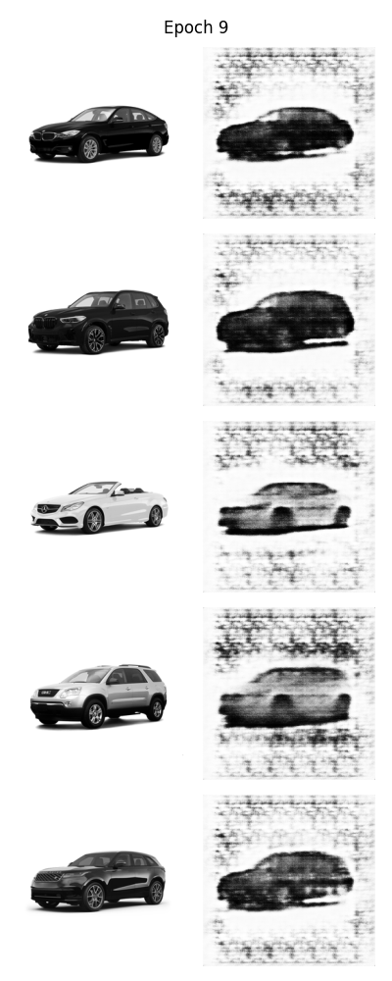
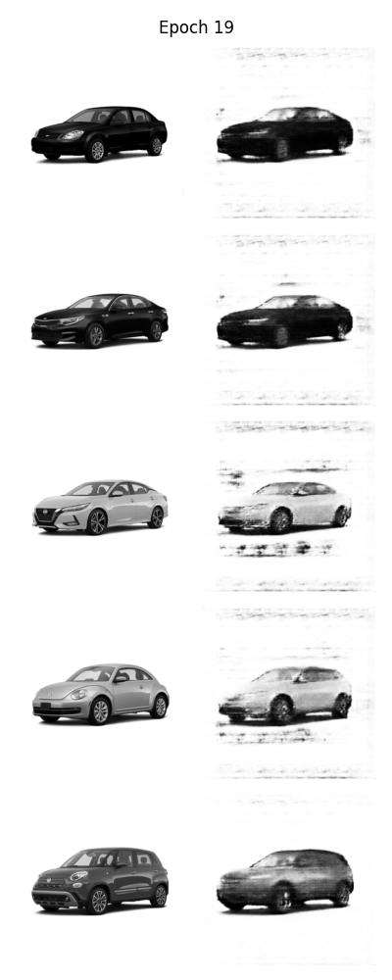
Where we’re at now

Slide 11
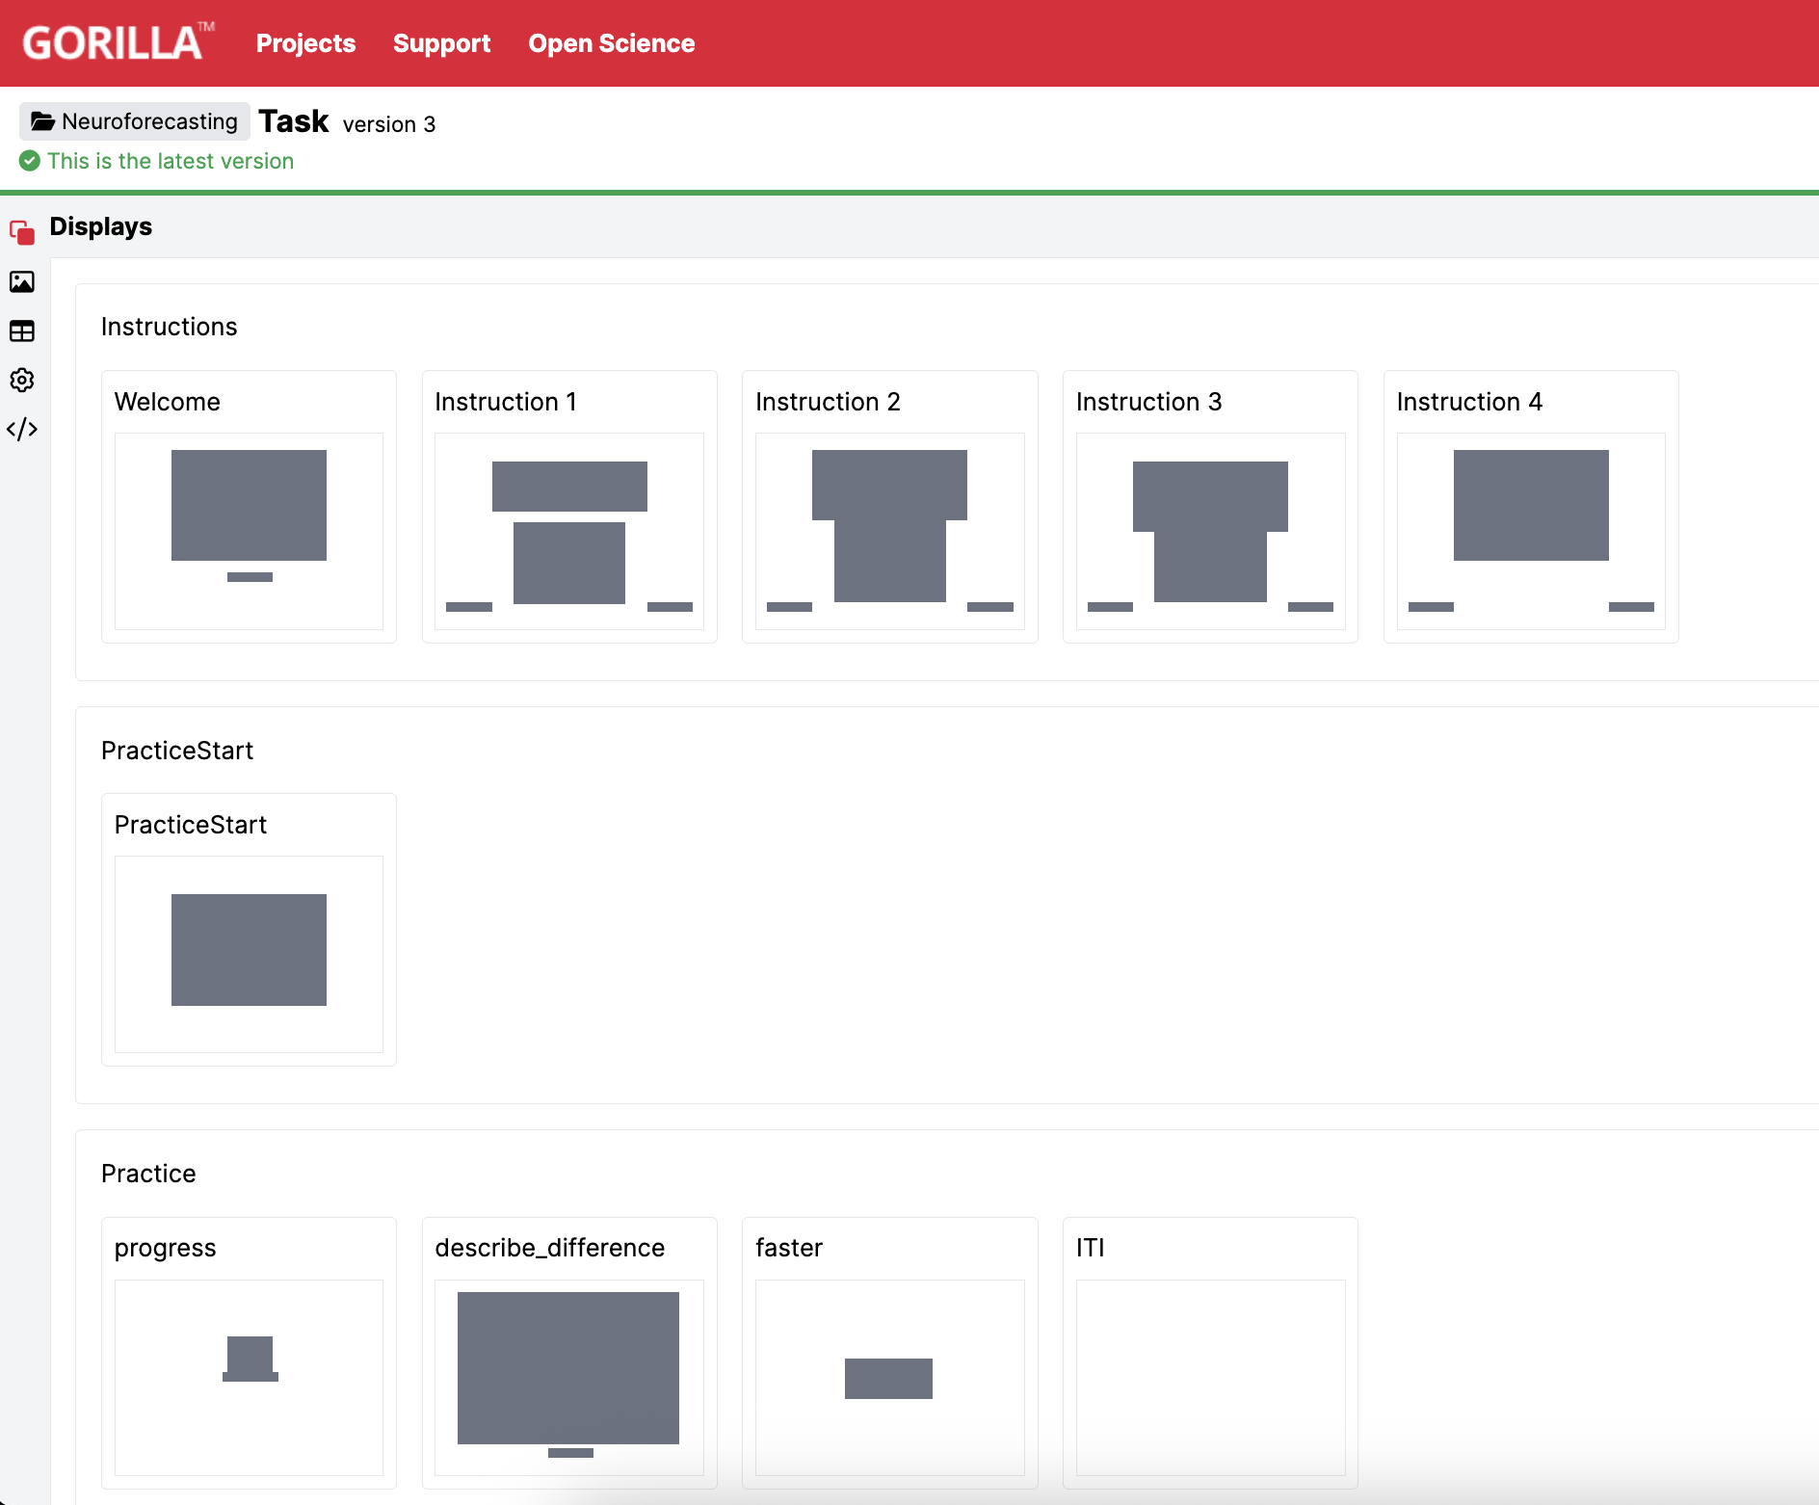
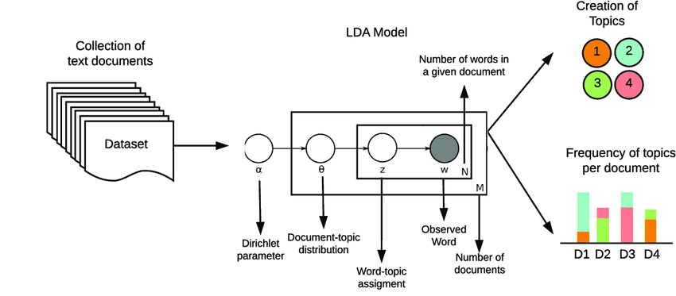
Surveys for Interpretation – LDA Text Analysis

Slide 12
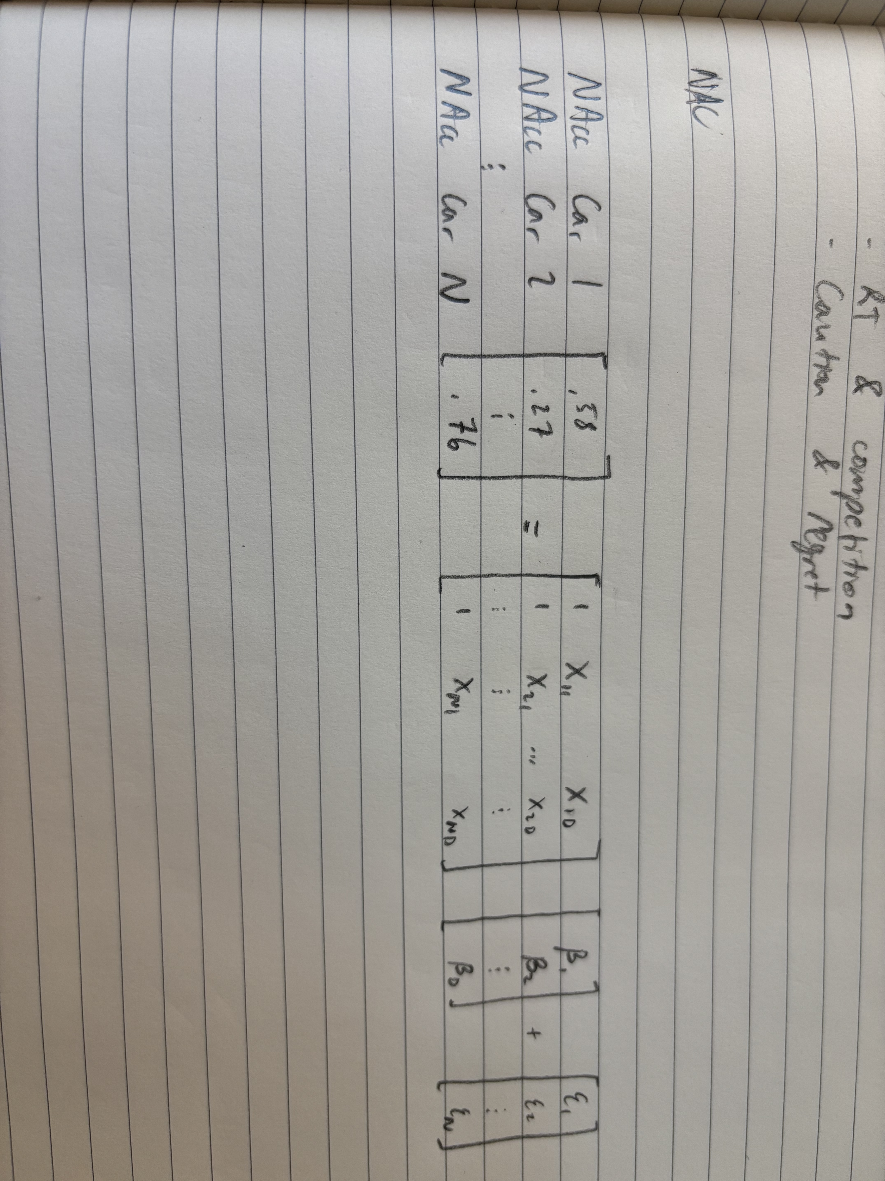
Surveys for Forecasting
What latent dimensions correlate with NAcc activity?
How can we interpret what these dimensions encode?
Can we design surveys to target these interpretations, rather than asking hypothetical purchasing decisions?

